Slide 1





Varsaw
(from 9th to 15th October, 2016)
Teaching 2 Teach: Gamify your class
Erasmus+ KA104
Multiculturalidad y Diversidad en la Educación de Adultos
CEPA “Maestro Martín Cisneros”
Cáceres 2016-2017
Notes:
1

Slide 2

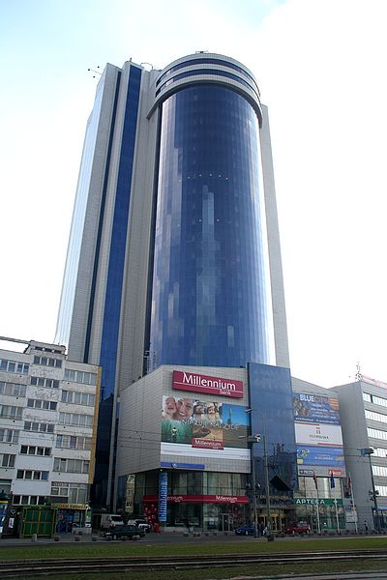
Teaching 2 Teach: Gamify your class
This course was developed by "Speak Europe" company.
There were two participants: María Jesús Puerto y José María Calvarro.
Next we’ll go over some of the things of interest that we were taught.
Multiculturalidad y Diversidad
en la Educación de Adultos

Slide 3
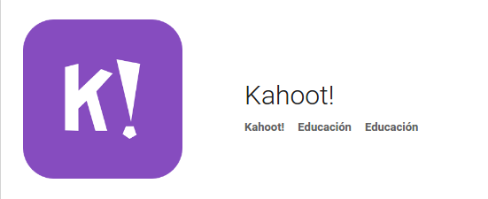
Teaching 2 Teach: Gamify your class
Join a learning game of Kahoot! - all you need is a game PIN from the host.
Kahoot! brings fun into the classroom – play, learn and unleash your secret classroom superpowers!
Kahoot! is a free game-based learning platform that makes learning awesome. The best way to play Kahoot! is in a group, like your classroom.
Questions appear on a shared screen and you answer on your own device.
Design the game in:
https://getkahoot.com/
Access to it in:
https://kahoot.it
Multiculturalidad y Diversidad
en la Educación de Adultos

Slide 4
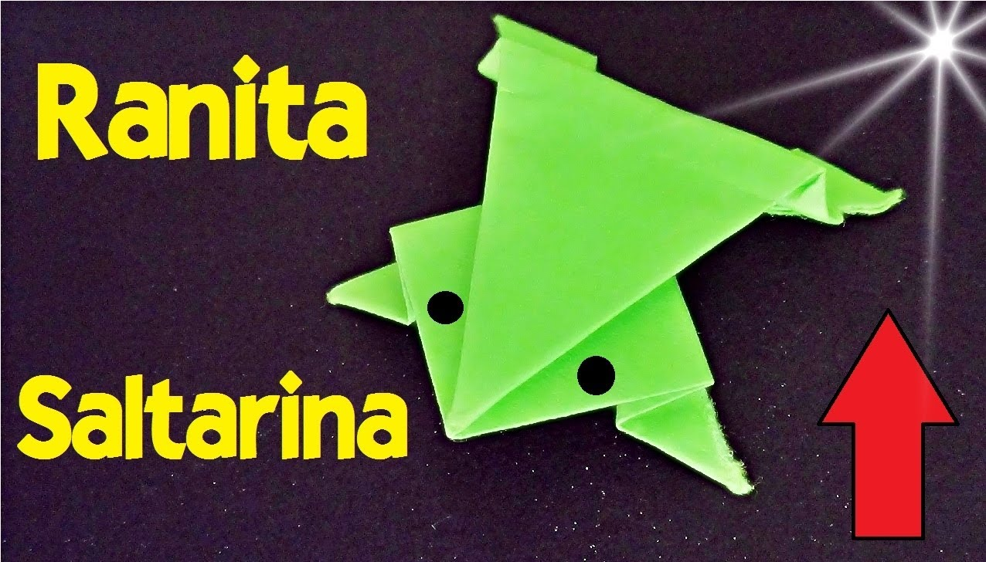
Teaching 2 Teach: Gamify your class
DROP OUT:
We were given instructions on how to make a paper frog. These instructions were vague and hasty which made us abandon the process.
It made us feel how a student would feel when he/she decides to leave a process.
Multiculturalidad y Diversidad
en la Educación de Adultos

Slide 5

Teaching 2 Teach: Gamify your class
Flipped classroom is an instructional strategy and a type of blended learning that reverses the traditional learning environment by delivering instructional content, often online, outside of the classroom.” Wikipedia
Foto de: flickr
Multiculturalidad y Diversidad
en la Educación de Adultos

Slide 6
Teaching 2 Teach: Gamify your class
We sort out the tools into four categories:
Video creation (To create a vídeo).
Video hosting (Platforms or online spaces to keep your videos).
Video interaction (Range of tools fit to adapt pre existing videos to our needs).
Learning management (Software applications for the administration of training programs).
Multiculturalidad y Diversidad
en la Educación de Adultos

Slide 7
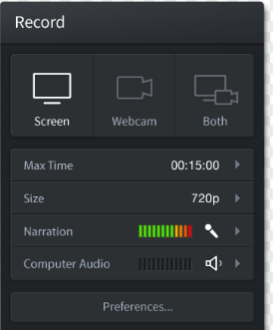


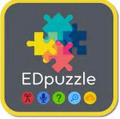
Teaching 2 Teach: Gamify your class
Some tools we managed (1 of 2):
Screen-cast
Google Drive
Video Creation
Video Hosting
YouTube
EdPuzzle
Video Hosting
Video Interaction
Multiculturalidad y Diversidad
en la Educación de Adultos

Slide 8




Teaching 2 Teach: Gamify your class
Some tools we managed (2 of 2):
One Note
Google Form
Video Interaction
Interaction tool
Thinklink
EduCreation
Video Interaction
Interaction tool
Multiculturalidad y Diversidad
en la Educación de Adultos

Slide 9

Teaching 2 Teach: Gamify your class
JOB SHADOWING: Visit and partaking in a Montessori private school.
“Montessori methodology started in Italy. It is a method and also a philosophy of Education. It was developed by doctor Maria Montessori, after her experiences with children at social risk.
Her ideas were based on respect of kids and their impressive learning capacity. She regarded them as the hope of humanity, giving them the chance to use freedom from the early years of their development”. Wikipedia
Multiculturalidad y Diversidad
en la Educación de Adultos

Slide 10

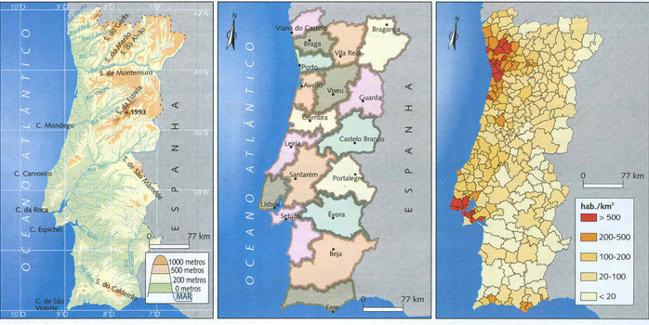
Teaching 2 Teach: Gamify your class
Difference between: territory and map
Territory
It is the real thing.
Map
It is the way you use to describe the territory.
Multiculturalidad y Diversidad
en la Educación de Adultos

Slide 11
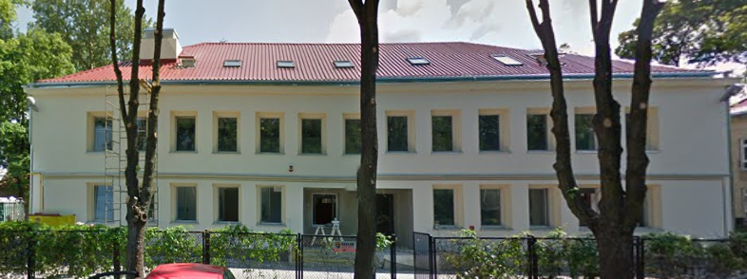
Teaching 2 Teach: Gamify your class
JOB SHADOWING: Visit and partaking in a TRADITIONAL SCHOOL
It was a Primary School, what we know in Spain as a “escuela concertada” ( a private school financed with public money).
We took part in a few lessons and gave the children a couple presentations:
A Spanish class for children.
Typical Spanish features.
Multiculturalidad y Diversidad
en la Educación de Adultos

Slide 12
Teaching 2 Teach: Gamify your class
Coaching Model: GROW MODEL
G - Goal = Setting up the aim to reach
R - Reality = Be aware of the point we are starting from y all we have to do to reach our goal
O - Options = Means we can gather to overcome the limitations
W - Will = Will and commitment that define the plan of action
Multiculturalidad y Diversidad
en la Educación de Adultos

Slide 13
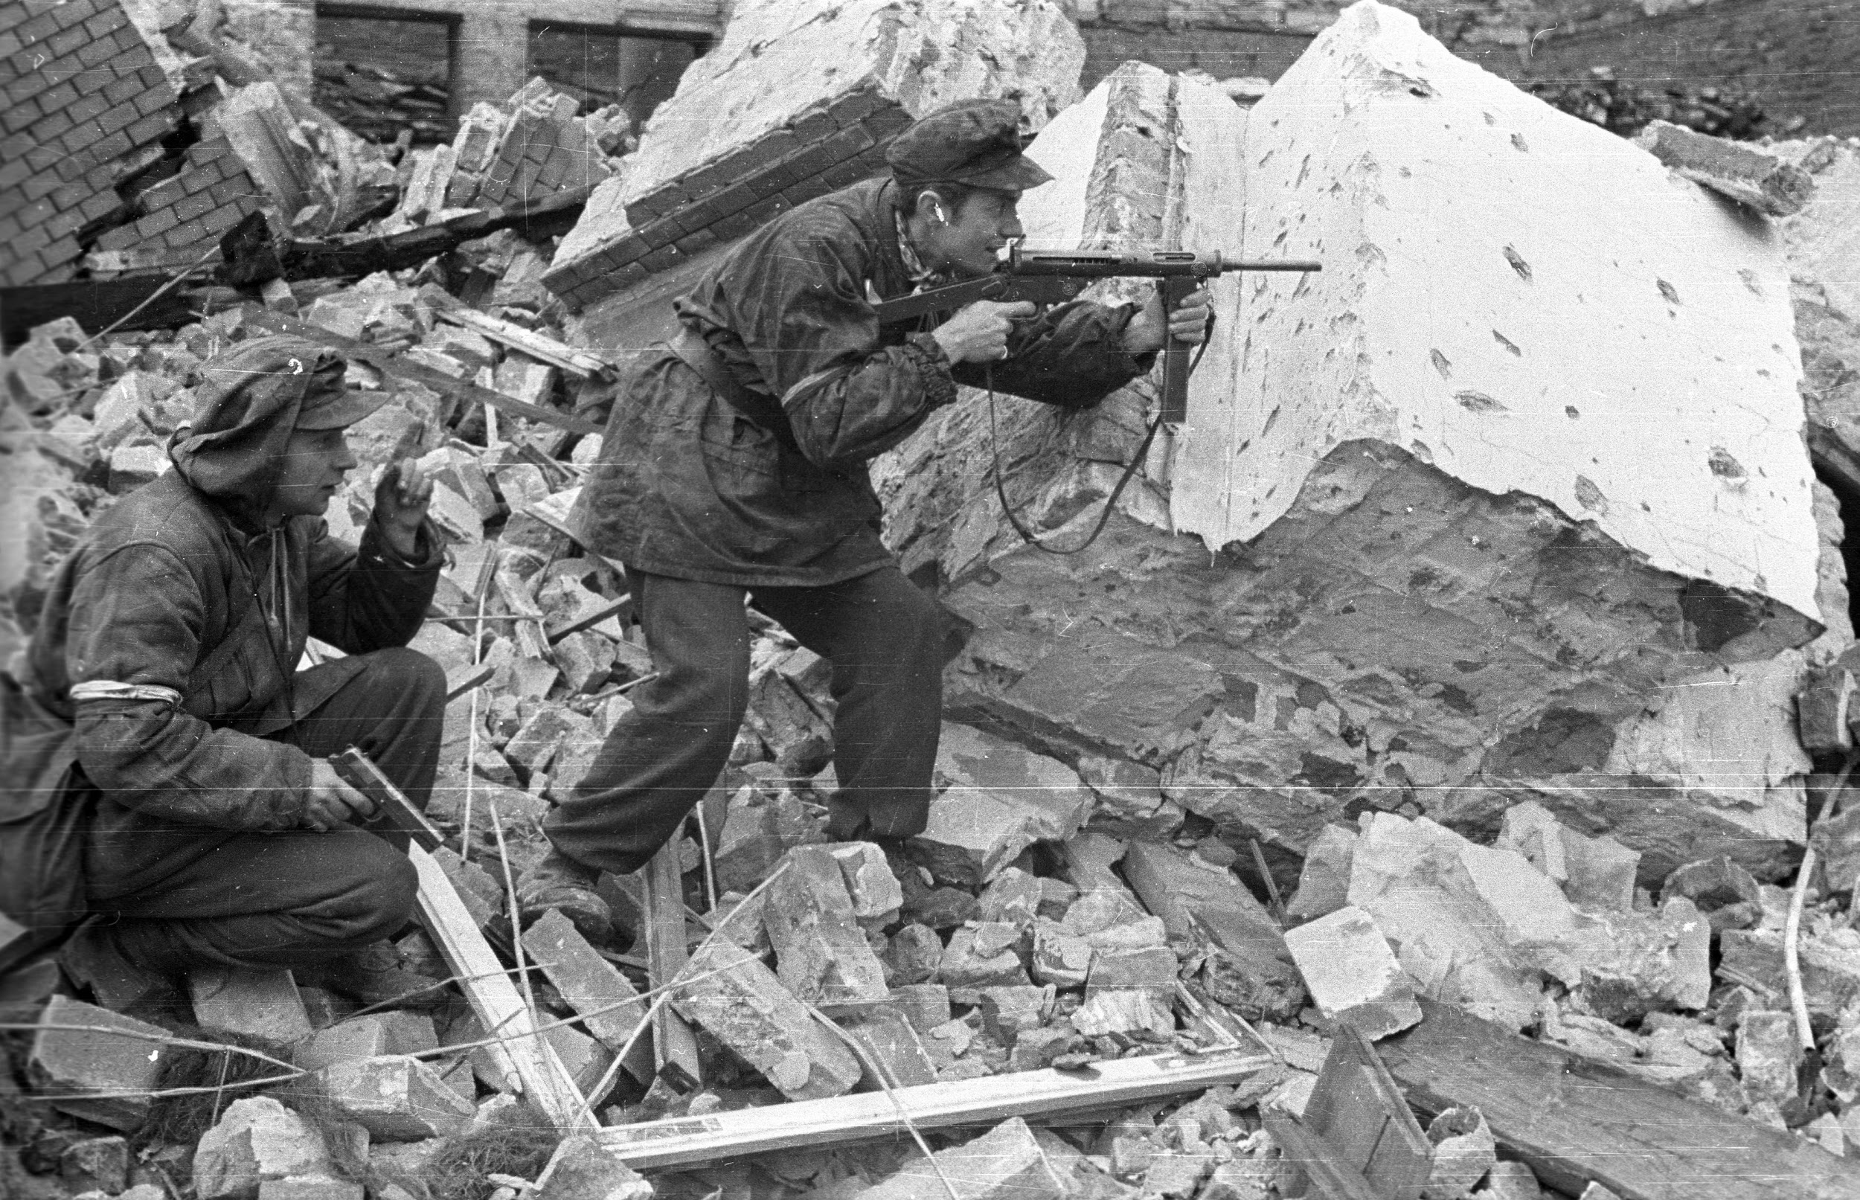
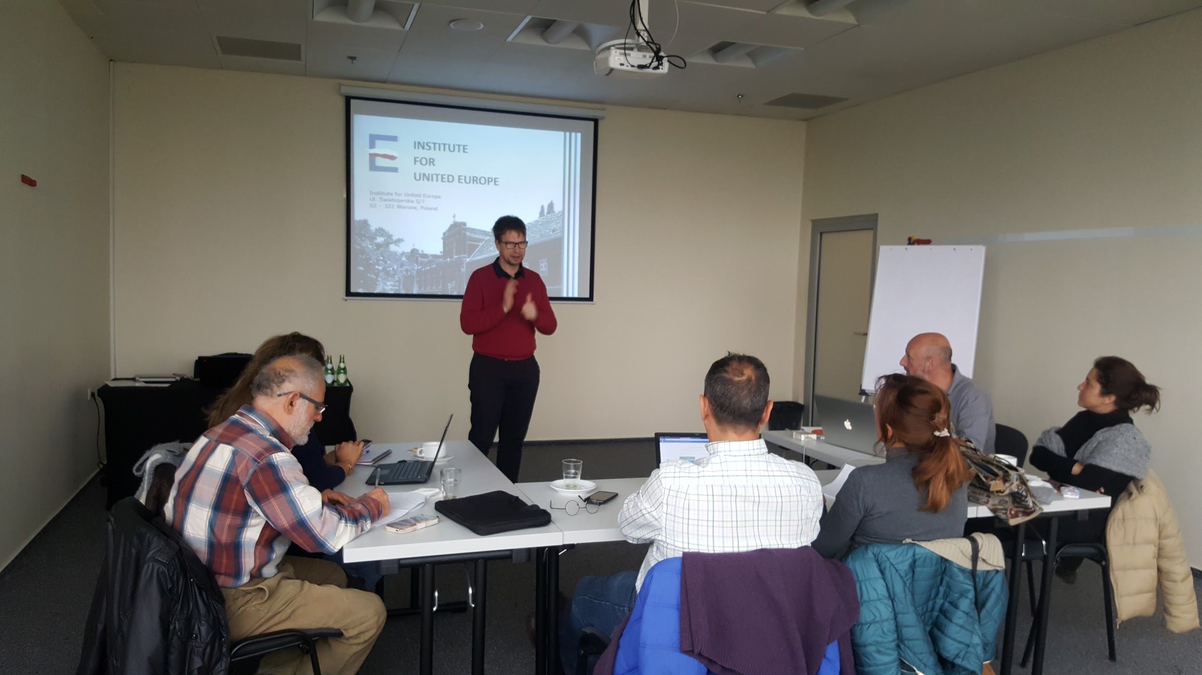
Teaching 2 Teach: Gamify your class
NOT YES
Multiculturalidad y Diversidad
en la Educación de Adultos

Slide 14
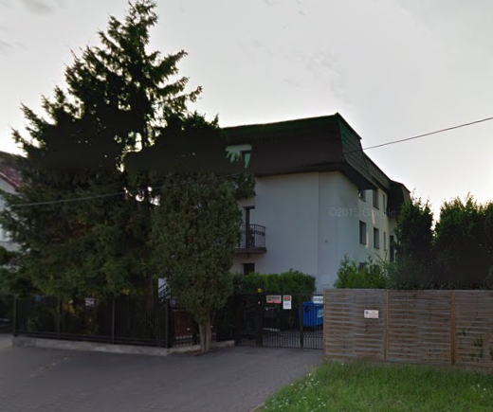

Teaching 2 Teach: Gamify your class
JOB SHADOWING: Visit and partaking in a traditional Secondary School
NASZA GYMNASIUM
It is a Secondary school.
Explanations and a Presentation about our country.
Multiculturalidad y Diversidad
en la Educación de Adultos

Slide 15
Teaching 2 Teach: Gamify your class
Thank you for your attention
This project has been funded with support from the European Commission.
This publication [communication] reflects the views only of the author, and the Commission cannot be held responsible for any use which may be made of the information contained therein.
Multiculturalidad y Diversidad
en la Educación de Adultos

