Slide 1
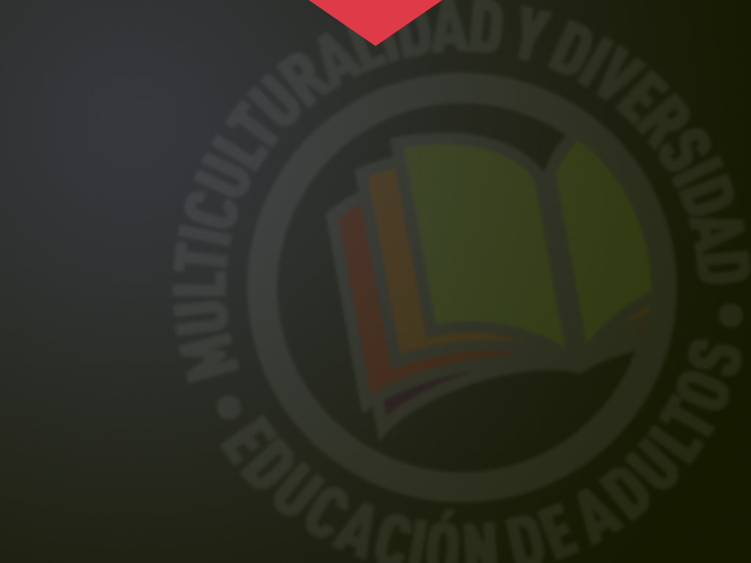




POLISH EDUCATION SYSTEM
Erasmus+ KA104
Multiculturalidad y Diversidad en la Educación de Adultos
CEPA “Maestro Martín Cisneros”
Cáceres 2016-2017
Notes:
1

Slide 2

Management of Polish Education System
National Education Ministry
Coordinte and develop lnational politics on education from central government.
Monitors the work of education inspectorate (kuratoria).
Cooperate with other levels in education matters.
Regional Education Administration
Competencies on the 16 regions of the country .
Regional Education Delegate (kurator). responsible of developing, in his area, education politics.
Nominated by the National Regional Delegate (wojewoda).
POWIAT (Administrative Districts)
Administrative Unit with an intermediate position between region and town .
379 education districts. each district manages and administrate Secondary High Education and Vocational training and other special national schools .
Multiculturalidad y Diversidad
en la Educación de Adultos

Slide 3
Compulsion
Non-university education system includes :
Early Education
Elementary Education
Secondary Education
Especials Education
Full time compulsory education
Starts at the age of 6 and finishes at the age of 16.
Full time compulsory education
Full time compulsory education
1 preparatory school year or 0 year .
6 Elementary School year.
3 school years of basic secondary education in the gymnasium .
Multiculturalidad y Diversidad
en la Educación de Adultos

Slide 4
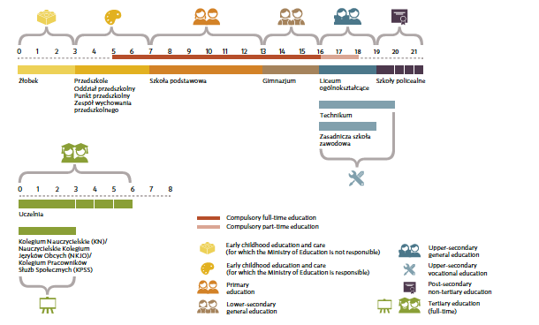
Stages of Polish Education System
Multiculturalidad y Diversidad
en la Educación de Adultos

Slide 5
Stages of Polish Education System
Early Chilhood Education
The main objective is to facilitate and stimulate childhood development until the 6 years of age when first literacy and calculation activities are introduced along year that, according to its compulsory character, shouldn’t be included in this section.
Teachers are required to have a certification of at least three years in specific training.
Elementary Education
It is divided in two cycles with the same duration. During the first one elementary general contents are taught in an integrated way. (7-10 years of age).
In the second cycle (0-13 years of age) elementary teachings are organized into compulsory subjects (polish language, history, mathematics foreign language, science, music, arts, technology, computing, physic education and religion/ethics) with a workload that goes from 23 to 28 hours per week depending on the cycle.
Multiculturalidad y Diversidad
en la Educación de Adultos

Slide 6
Stages of Polish Education System
Lower Secondary General Education
Once the certificate of Elementary Education is acquired students get to the gymnasium (Lower Secondary Basic Education school). During three school years, they are introduced to formal and scientific teaching through a specific methodology in different subjects.
The subjects mentioned previously for elementary education are completed with citizenship education, physics and astronomy, chemistry and geography, with a workload of 31 hours per week.
At the end of the stage, students will take an external final test whose marks, together with the academic record, predetermine their access to a Upper Secondary Education School.
Teachers are required to have a Degree or Licencjat.
Multiculturalidad y Diversidad
en la Educación de Adultos

Slide 7
Stages of Polish Education System
Upper Secondary General Education
It offers a preparatory training to access to upper education once maturity exam or baccalaureates test .
These teachings can be taken in different schools :
Secondary General Education schools (liceum ogólnokształcące).
Secondary Specialized Education schools (liceum profilowane).
Secondary technical schools (technikum).
Teachings are taught in subjects and, independently of the type chosen, all secondary schools follow the basic curriculum that contains traditional subjects.
Workload is 32-33 hours per week. In a general way and independently of the education stage taken by the students, it is necessary to pass all the subjects to access next course.
Teachers are required to be in possession of Magister Degree.
Multiculturalidad y Diversidad
en la Educación de Adultos

Slide 8
Stages of Polish Education System
Vocational Training
At the end of Secondary General Education, the education offer is completed with a broad range of centers where any vocational training referred to any of the existing professions can be taken.
Basic Vocational Training (zasadnicza szkoła zawodowa) lasts at least two school years and maximum three school years.
The final certificate reflects the technical qualification necessary to work. It also allows students to access Upper Secondary General Education in complementary secondary schools (uzupełniające liceum ogólnokształcące) or complementary technical schools (technikum uzupełniające) and, at the end of these studies, have Access to maturity test .
Finally, we have to emphasize the role of studies offered by post secondary schools (szkoły policealne). They last more than six months and less than two years and a half. It final goal is to develop technical training of all those who have obtained the Matura certificate and are not taking upper training.
Multiculturalidad y Diversidad
en la Educación de Adultos

Slide 9
Stages of Polish Education System
University Education
Depending on the education offer of each center, the profile and its duration. Students can obtain:
a three or four years degree licencjat.
a five-six years degree magister.
The third cycle is composed by PhD studies and other post degree studies.
Multiculturalidad y Diversidad
en la Educación de Adultos

Slide 10
Types of Centres and Funding
Early childhood education is taken in the kindergarten (przedszkole). Preparatory 0 year can be taken in this same center or in special sections in elementary schools (oddziały przedszkolne).
Lower Secondary General Education tage is taken exclusively in the gimnasium, while upper general secondary education is taken in high schools (licei) that offer general or specialized training and in technical and complementary schools.
University teaching is taken in Universities, technical schools and academies.
Independently of the level of management, funding of education system is a part of national budget .
In national schools, compulsory education and secondary education are free to all students, as well as well as day class in university.
Elementary and Secondary education, including baccalaureate, are almost public.
Upper teaching, together with early childhood education and post secondary education are the only stages where non-public teaching is important.
About one third of university students take their courses in 300 non-public centers.
Multiculturalidad y Diversidad
en la Educación de Adultos

Slide 11
Additional Interesting Data
Poland is a country where there are no illiterate people and with a low rate of academic failure in all education stages, especially in non-university ones.
Its education system, almost completely public, is well organized and it is characterized by elaborated guidelines.
The annual budget per student as a percentage of GDP is above the average of the OECD.
In the 2003 Pisa Report, Polish students scored slightly below average, except for reading, and somewhat better than the results of Spanish students.
The improvement of Polish students' scores in relation to the Pisa 2000 Report was striking in all competences assessed.
This project has been funded with support from the European Commission.
This publication [communication] reflects the views only of the author, and the Commission cannot be held responsible for any use which may be made of the information contained therein.
Multiculturalidad y Diversidad
en la Educación de Adultos

