Slide 1
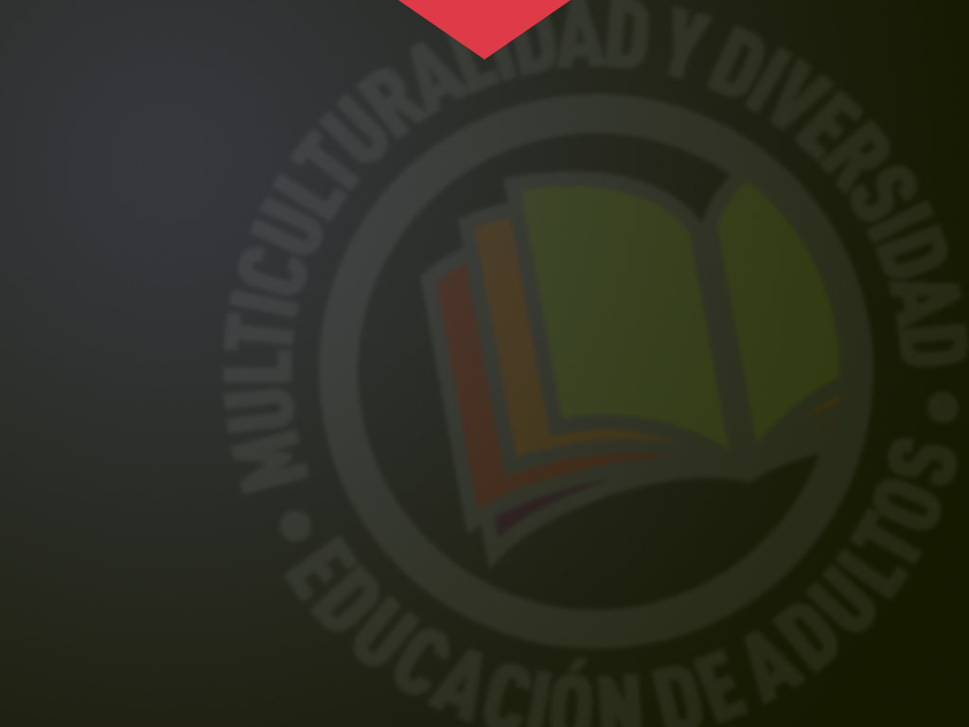




ITALIAN EDUCATION SYSTEM
Erasmus+ KA104
Multiculturalidad y Diversidad en la Educación de Adultos
CEPA “Maestro Martín Cisneros”
Cáceres 2016-2017
Notes:
1

Slide 2

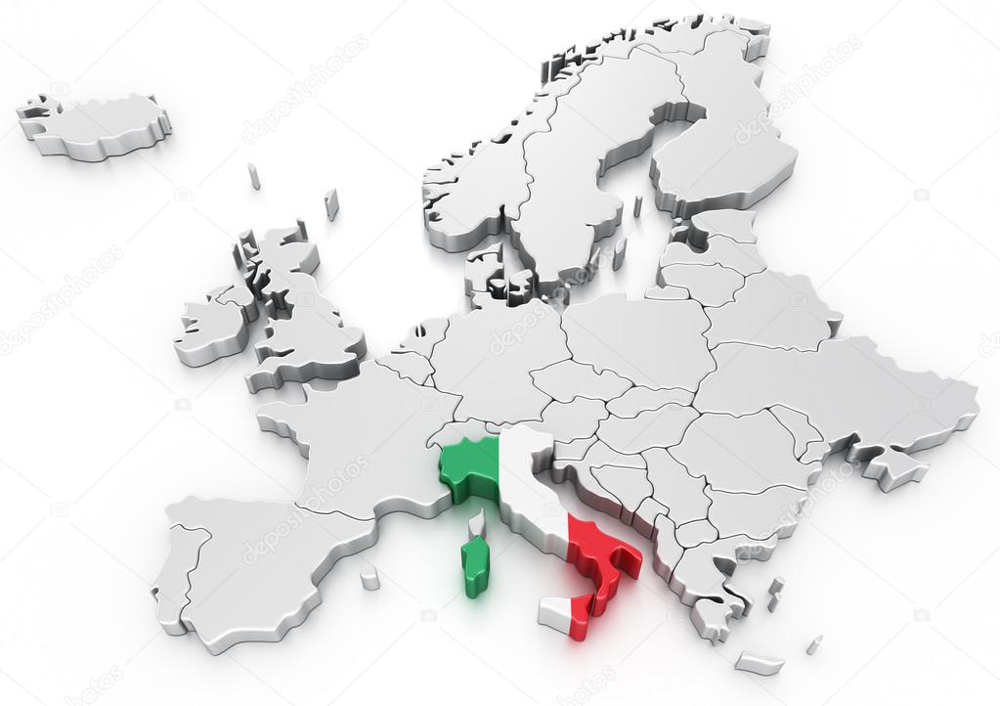
Italian Education System
Multiculturalidad y Diversidad
en la Educación de Adultos

Slide 3
Principles
Subsidiarity principle, a great administrative decentralization that allows teaching institution didactic and organization autonomy.
Coherence with European guidelines, improve general formative level encouraging participation in formative actions of lifelong learning programs.
Multiculturalidad y Diversidad
en la Educación de Adultos

Slide 4
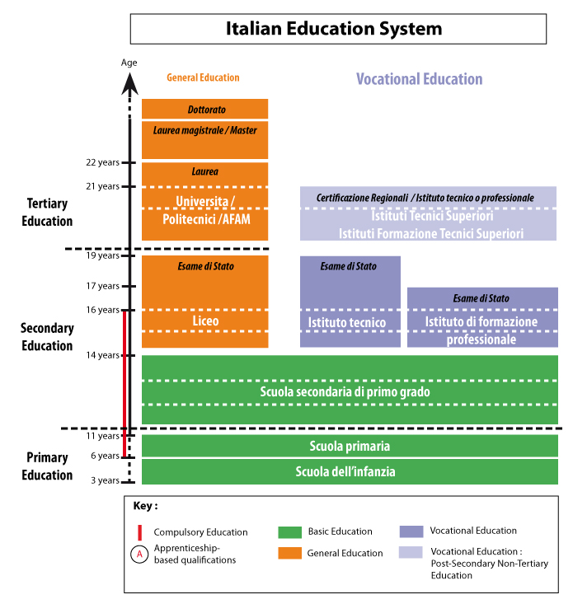
Structure
Multiculturalidad y Diversidad
en la Educación de Adultos

Slide 5
Infant Schooling
Non-compulsory
3-6 years
Objectives:
To promote development of children’s identity, autonomy and competency and introduce them in citizenship.
Multiculturalidad y Diversidad
en la Educación de Adultos

Slide 6
First Cycle-Primary Education
Compulsory and free level.
It is organized in five school years, from 6 to 11 years of age.
First school year, it is associated to infant school.
Two consecutive biennium.
This structure only has a didactic aim, not an organization one.
Aim: acquisition of essential knowledge and skills to develop basic cultural competencies.
Subjects: Italian, Geography, Mathematics, History, Science, Technology and computing, music, art, physic education and religion (non-compulsory). “Citizenship and Constitution”.
.
Methodology: without prejudicing teaching autonomy, it considers the improvement of students’ experience and knowledge, promotion of exploring and discovery activities, encouraging cooperative learning, self-awareness of their learning strategies, routes through laboratories.
Assessment: continuous and global.
There is no final test to access First Grade Secondary Education.
Promotion: it is made considering the level of acquisition of objectives and competencies.
Multiculturalidad y Diversidad
en la Educación de Adultos

Slide 7
First Cycle Secondary Education
It is offered in First Grade Secondary Schools.
From 11 to 14 years of age.
It is organized in three school years divided into:
A Basic biennium.
A year of tutoring for second cycle.
Aim: to acquire the essential knowledge and skills to develop basic cultural competencies. Particularly, in this stage of the teaching students have access to subjects such as a point of view about reality and as a way of acquiring information, interpreting and representing the world.
Subjects: Italian, English and second foreign language, history, geography, mathematics, science, music, arts and design, physic education, technology, religion (non-compulsory), “citizenship and constitution”.
Assessment: annual and periodic. At the end of third year there is a national school exam to access second cycle.
Promotion and certificate: it is made taking into account the level of acquisition of objectives and competencies. Diploma di licenza conclusive del primo ciclo di instruzione.
Prospects and connections with other studies: Second cycle of teaching and training educative system.
Multiculturalidad y Diversidad
en la Educación de Adultos

Slide 8
Second Cyclo-Upper Secondary School
From 14 to 19 years of age.
Teaching is compulsory until 16 years (1st biennium of second cycle).
Access: after finishing first cycle.
It is organized in two pathways
2nd Grade General secondary school. It includes licei and technical and professional schools within the State competence.
Vocational and professional training, within the regional competence.
Multiculturalidad y Diversidad
en la Educación de Adultos

Slide 9
Licei
Five school years.
It is organized in two consecutive biennium and one additional course.
1st biennium: it has the objective of deepen and developing knowledge, skills and competencies acquired in first cycle.
2nd biennium: knowledge, skills and competencies acquired from first cycle are developed.
Final year: students must reach the specific learning objectives contained in curriculum and complete their own educative, cultural and professional profile.
Tipos: Types: artistic, classic, linguistic, music, scientific and social sciences.
After the common biennium, art, scientific and social science lyceum offer other options.
In all licei, during the fifth year CLIL (Content and Language Integrated Learning) is compulsory, teaching a non-linguistic language in a foreign language.
Methodology: in the last ten years they have focus on prevention, study skills, empowerment and retaking, as well as, the arise of ICTs.
Assessment: periodic and annual. At the end of the fifth year a national school test is taken.
Promotion and certificate: it is made taking into account the level of acquisition of general and specific objectives of each pathway and the basis of general knowledge, as well as critical capacities of the candidate. Diploma liceale and certificate
Prospects and connections with other studies: access to university and upper artistic and musical training and Upper Technic Instructional training.
Multiculturalidad y Diversidad
en la Educación de Adultos

Slide 10
Upper Secondary Vocational Training
It is organized through the technical schools and professional schools.
It lasts five school years.
It is structured into:
1 compulsory biennium
1 triennium divided into a biennium and the last course.
Studies:
Technical Schools offer pathways in economics and technology that are organized into 2 or 9 directions. This are divided into 11 options to which different curricular files are established. In these files are professional and learning results are individualized.
Professional schools offer pathways into service and industry and handicraft sectors that are organized into 4 and 2 directions. These re divided into 10 options to which the same information provided in technical schools are valid.
Assessment: periodic and annual. At the end of the fifth year a national school test is taken.
Promotion and certificate: Diploma on technical training and diploma of professional training, together with a certificate.
Multiculturalidad y Diversidad
en la Educación de Adultos

Slide 11
Regional Vocational Training (IFP)
It has a variable duration, 3 school years minimum
It has pathways of three or four school years
It can be developed by firms, vocational training formative structures that are credited by regions according to common national criteria and national secondary high schools.
Access::
inishing first cycle and being less than 15 years of age.
Students who access through any different pathway must be less than 18 years of age.
Assessment: periodic and final (with a qualification test).
Promotion and certificate: Certificate of professional qualification (Operatore) in the case of three school years pathway and Certificate of Technician in four years pathway.
Prospects and connections with other studies:
After three school years: access to labor market.
Possibility of acquiring further qualifications that can be needed to access labor market and Upper Technical training.
With a qualification of 4 years, at least, students are allowed to take a school year to prepare national test which is useful to access university and High Art, musical and dancing education.
Multiculturalidad y Diversidad
en la Educación de Adultos

Slide 12
Upper Training
It is organized into:
University
High Art, musical and dancing education.
Upper technical training and education in higher technical institutes (HTI).
Education in higher schools.
Multiculturalidad y Diversidad
en la Educación de Adultos

Slide 13
University and FLAD
There are two types of training similar to university.
Higher schools for linguistic mediators or translators.
Higher schools specialized in psychotherapy,.
Se distinguen tres ciclos:
FIRST CYCLE:
Three school years.
Requirements: having obtained the Diploma in Higher Secondary Education.
Certification: Laurea (University) and First Level Academic Diploma (FLAD)
SECOND CYCLO:
Two school years.
Single cycle: 5 – 6 years (in some university specialties)
Requirements: Laurea (University) and First Level Academic Diploma (FLAD). To access the single cycle: Diploma of Higher Secondary Education.
Certification: Laurea magistrale or Degree of Second Cycle of University Master or specialized diploma (University) and Academic diploma on research training or Academic diploma of specialization or Proficiency Diploma or Master (FLAD).
THIRD CYCLE PhD
Certificación: Título de doctor en investigación (Universidad) y Diploma de formación en investigación (Afam).
.
Multiculturalidad y Diversidad
en la Educación de Adultos

Slide 14
Higher Technical Learning and Training
Duración: 4 semesters (1.800 - 2000 h)
They offer training in the following technological areas: energy efficiency, sustainable mobility, ICTs in life, ICTs for made in Italy, innovative technologies to cultural goods and activities and tourism, ITCs.
Access: Diploma in Higher Secondary Education.
Certification: Advanced technician certificate.
Prospects and connections with other studies: access to civil servant tests, University and labor market.
Multiculturalidad y Diversidad
en la Educación de Adultos

Slide 15
Sources
http://www.indire.it/lucabas/lkmw_file/eurydice///QUADERNO_per_WEB.pdf
http://mavoieproeurope.onisep.fr/es/files/2013/03/italie_es.jpg
https://previews.123rf.com
This project has been funded with support from the European Commission.
This publication [communication] reflects the views only of the author, and the Commission cannot be held responsible for any use which may be made of the information contained therein.
Multiculturalidad y Diversidad
en la Educación de Adultos

