Slide 1





FINNISH EDUCATIONAL SYSTEM
Erasmus+ KA104
Multiculturalidad y Diversidad en la Educación de Adultos
CEPA “Maestro Martín Cisneros”
Cáceres 2016-2017
Notes:
1

Slide 2

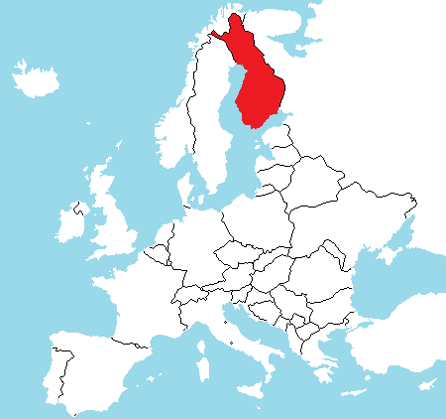
Finnish Educational System
Multiculturalidad y Diversidad
en la Educación de Adultos

Slide 3
Principles
Equity
Confidence and responsibility
Education is free in all levels
Academic support and tutoring is available to all students. Individual capabilities should be maximized.
Education for students with special education needs are developed together with conventional education.
Great effort to support ethnic minorities.
Focus on lifelong learning
Great autonomy in any educational level
Quality is guaranteed through tutoring, not controlling.
Multiculturalidad y Diversidad
en la Educación de Adultos

Slide 4
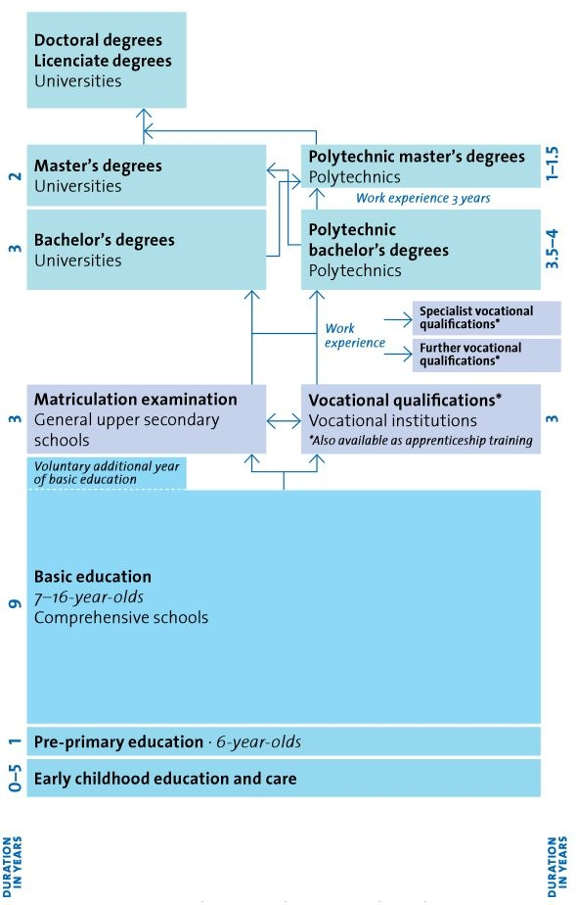
Structure
Multiculturalidad y Diversidad
en la Educación de Adultos

Slide 5
PRE-SCHOOL EDUCATION
Compulsory and free, it can be provided in nursery school or elementary school.
From the age of six.
It lasts one school year.
It's organized by municipalities.
Skills, knowledge and basic capacities on different learning areas are acquired according to age and capabilities.
Learning through game methodology is prioritized.
Multiculturalidad y Diversidad
en la Educación de Adultos

Slide 6
Elementary Education
It's free and compulsory.
Aged to 7 to 15.
9 degrees or courses, plus one year dedicated to students with special educational needs.
From 7 to 12 years of age: general teacher.
From 12 to15 years of age: specialized teacher.
Objectives: to support students' comprehensive development as individuals and ethically responsible members of society, and to provide them with the necessary knowledge and skills.
Subjects:
Language and Literature •Foreign language A • Foreign language B • Mathematics • Environment + Biology and Geography • Physics and Chemistry • Hygiene • Religion /Ethical-philosophic education • Music • Arts • Handicraft • Physic Education • Domestic Economy • Tutoring • Elective subjects .
No diploma or certificate acquired.
Multiculturalidad y Diversidad
en la Educación de Adultos

Slide 7
High Secondary Education
2 opciones:
General Secondary Education o Baccalaureate.
Secondary Education for Professional Training.
Both options can be combined.
Non-compulsory and free.
Aged 16 to 19.
3 years long.
Objectives: to support students' development as balanced members if society ad to provide them with the necessary knowledge and skills to continue learning, as well as, to lifelong learning and self-development.
Access: to have finished Elementary Education .
Prospects and connections: University, Higher Professional Training Schools or Vocational Training at the Upper Secondary Level and labor market.
Multiculturalidad y Diversidad
en la Educación de Adultos

Slide 8
Baccalaureate
Objectives: The Council of State decides the general objectives at the national level, as well as the hourly distribution among subjects, group of subjects and tutoring. The National Council of Education decides the main teaching objectives and contents ratifying the guidelines to be followed by teaching programs, according to which educational equipment made local programs.
Some Upper Secondary Schools are specialized in areas such as sports, arts o r music. Furthermore, there are some high schools where international Baccalaureate can be took and another one with Reifeprüfung studies.
Evaluación: National Baccalaureate Test: it evaluates whether students have acquired the knowledge and skills included in the teaching program for General Upper Secondary Education and if they have reached the level of maturity established through the objectives of the cycle.
Diploma: Baccalaureate Diploma.
Multiculturalidad y Diversidad
en la Educación de Adultos

Slide 9
Secondary Education on Vocational Training
It’s composed:
Basic Professional Training (3 years).
Complementary Professional Training.
Regional competence.
It is organized in Secondary schools and through apprenticeship contract system.
Teaching: 140 weeks. Academic qualifications and apprenticeship in a workplace.
8 teaching areas: • Technology and transport • Tourism, Catering and Domestic Services • Natural resources and environment • Health and Social Services • Culture • Business and Administration • Natural Sciences • Arts and Education
Diploma: Basic Professional Training Diploma. Diplomas on complementary education, professional training and specialized professional training can be obtained through a skill test, regardless of the process of acquisition of the professional capacity.
Multiculturalidad y Diversidad
en la Educación de Adultos

Slide 10
Upper Education
Two complementary levels :
Upper Professional Training Schools.
University.
Objectives:
To satisfy the educational needs of society.
To produce professionals with a training level high enough to the needs of business, industry and the other areas of society.
Multiculturalidad y Diversidad
en la Educación de Adultos

Slide 11
Upper Professional Training School
Objetivo: to satisfy the educational needs of society and to produce professionals with a training level high enough to the needs of business, industry and the other areas of society .
It is organized in educational cycles.
Teaching: basic and professional teaching, elective subjects, internship and an end of certificate assignment .
Access:
Internship and an end of certificate assignment.
Baccalaureate Diploma.
Certificate on Basic Professional Training or similar studies obtained abroad.
Basic Level Certificate and three years of professional background. These programs are focused to adults who are already working and posses a Certificate on upper professional teaching or any similar certificate on upper education.
Multiculturalidad y Diversidad
en la Educación de Adultos

Slide 12
University
There are 4 types of teaching:
Kandidaatti. First level universitaty degree, 3 years.
Maisteri. Second level universitaty degree, 2 years.
Lisensiaatti. Intermediate degree between Kandidaatti and Maisteri (volonteer).
Tohtori. PhD, -4 years.
Access:
National Baccalaureate Test.
Baccalaureate Diploma or Certificate on Upper Professional Training.
Others.
Multiculturalidad y Diversidad
en la Educación de Adultos

Slide 13
Sources
www.oph.fi/download/124281_sistema_educativo_de_finlandia.pdf
www.oph.fi/download/151278_education_in_finland_spanish_2013.pdf
https://cdn.goconqr.com
http://www.fulbright.fi/sites/default/files/styles/large/public/education-system-finland-oph.jpg?itok=Jy6qXN8H
This project has been funded with support from the European Commission.
This publication [communication] reflects the views only of the author, and the Commission cannot be held responsible for any use which may be made of the information contained therein.
Multiculturalidad y Diversidad
en la Educación de Adultos

