Slide 1





SPANISH EDUCATIONAL SYSTEM
Erasmus+ KA104
Multiculturalidad y Diversidad en la Educación de Adultos
CEPA “Maestro Martín Cisneros”
Cáceres 2016-2017
Notes:
1

Slide 2

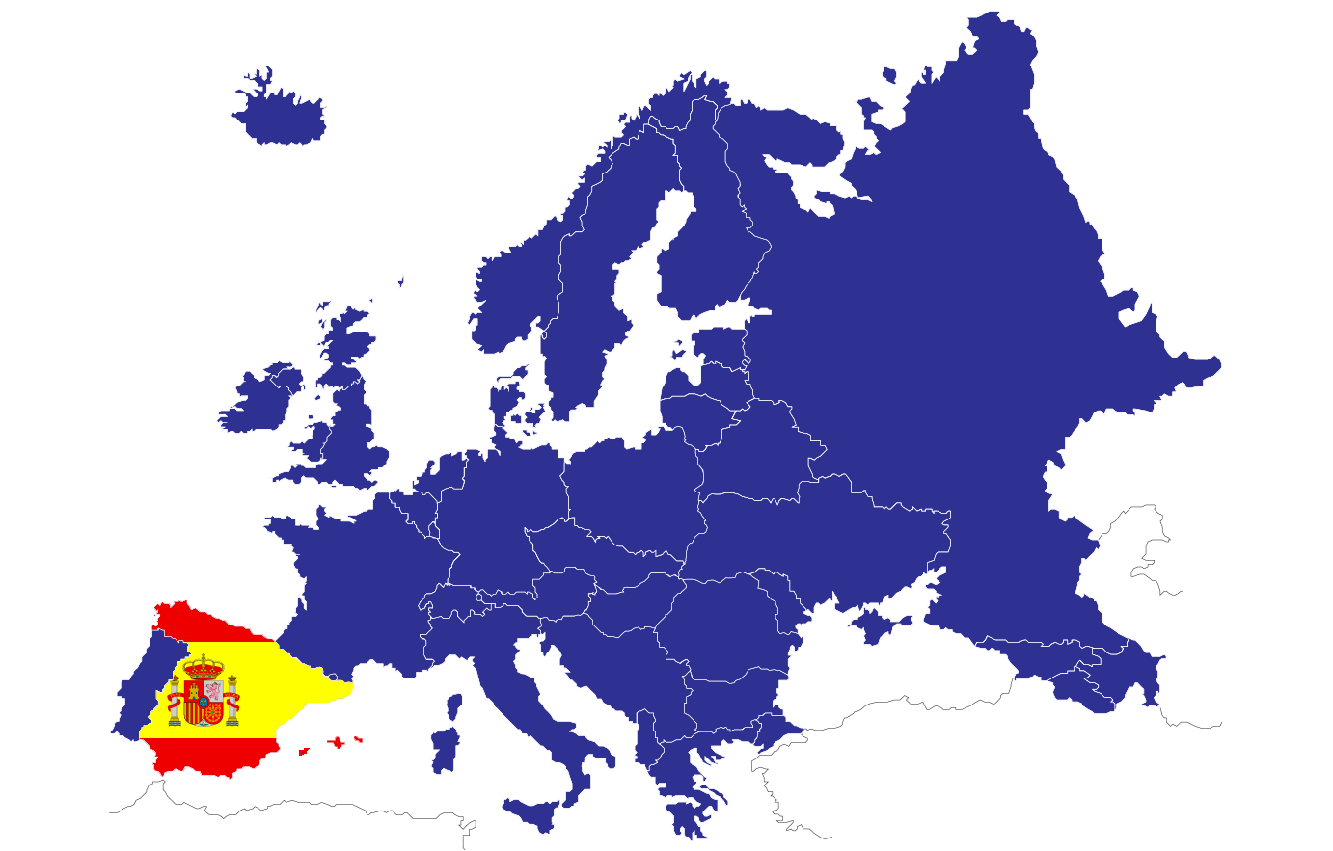
Spanish Educational System
Multiculturalidad y Diversidad
en la Educación de Adultos

Slide 3
Principles
Quality and equity
Increasing school autonomy
Reinforcement in school leader’s management
External assessment at the end of each educational level
Rationalization of educational offer and increasing flexibility to choose different options.
Transmitted values to encourage personal freewill, responsibility, democratic citizenship, solidarity, tolerance, equality, respect and justice, as well as contributing to overcome any kind of discrimination.
Multiculturalidad y Diversidad
en la Educación de Adultos

Slide 4
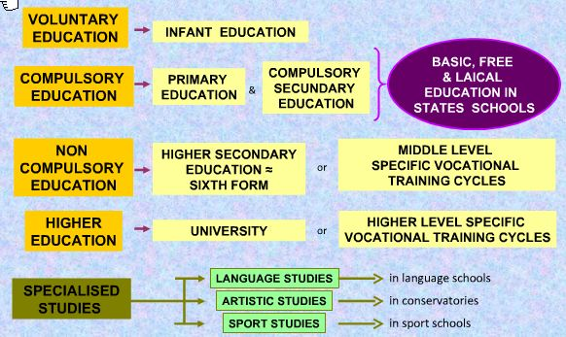
Structure
Multiculturalidad y Diversidad
en la Educación de Adultos

Slide 5
Pre-School Education
Non-compulsory
It is organized in two educational cycles
First cycle: 0-3 years of age. Three school years.
Second cycle: 3-6 years of age. Three school years.
Objectives
To assist the physical intellectual, social, development, emotional and personal development for boys and girls and compensate the present inequalities.
Áreas (2nd cycle )
Self-awareness and personal autonomy
Environmental studies
Language: communication and representation.
Multiculturalidad y Diversidad
en la Educación de Adultos

Slide 6
Elemmentary Education
Compulsory and free level.
It is organized in six school years, from 6 to 12 years of age.
Purpose: to provide students with knowledge as oral expression and comprehension, writing, reading, calculus, acquisition of basic aspect of culture, habits of coexistence, study and work, artistic like, creativity and affectivity: so that they have a complete formation to prepare them for Compulsory Secondary Education .
Subjects: Core subjects: Language and Literature, Mathematics, Sciences, Social Sciences and Foreign language; Particular subject areas (at least three out of six): physic education, Religion or Social and Civic Values, Arts, optional foreign language.
Competencies: Linguistic Communication, Mathematic Competence and basic Competencies on science and technology, Digital Competencies, Learning to learn, Social and civic Competencies, entrepreneur spirit and cultural conscience and expressions.
Methodology: it is focused on personal necessities and adapted to the different paces of learning.
Assessment: continue and global, comprising the whole subjects.
At the end of 3rd and 6th grades individual assessment will be made.
Promotion: it is made according to the degree of acquisition of objectives and competencies.
An academic year can only be repeated once with a specific plan of reinforcement.
Multiculturalidad y Diversidad
en la Educación de Adultos

Slide 7
Compulsory Secondary Education
Compulsory and free.
From 12 to 16 years of age.
It is structured in four school years divided into two cycles.
First cycle: three school years (1st, 2nd, 3rd)
Second cycle: one school year (4th).
Purpose: To acquire the basic elements of culture: artistic, scientific and technological.
It is organized according to the principles of education in common and attention to diversity. It emphasizes educational and professional tutoring.
Basic competences: they are the same as in Elementary Education.
Subjects: core, specific and free elective subjects. In the second cycle we find the academic training targeted to Baccalaureate and applied teachings targeted to Vocational Training.
Assessment and promotion: continue, formative and inclusive. Students promote when positive assessment is got in all the subject or negative in a maximum of two subjects.
An academic year can only be repeated once and twice during the stage.
Certificate: Certificate on Compulsory Secondary Education.
Prospects and connection with other studies: access to Baccalaureate, middle grade of Professional Training and labor market.
Multiculturalidad y Diversidad
en la Educación de Adultos

Slide 8
Basic Vocational Training
Compulsory and free.
BPT cycles consists on two school years addressed to people who have not finished Compulsory Secondary Education and want to continue their learning towards a Vocational Training area.
Pedagogic features are adapted to specific characteristic of students. It encourages cooperative tasks, educational and professional tutoring.
Requirements: To be, at least, 15 years old and not older than 17; to have taken 3rd course of CSE. In some exceptional cases, access can be obtained just with the 2nd course of CSE, to have a recommendation from the teaching personal of CSE and legal tutors consent.
Areas: they are associated to unit of competencies from the National Professional Qualifications Framework.
Areas associated to common teaching aspects: Communication and Social studies, applied science studies, apprenticeship in workplaces.
Certificate: Certificate on Basic Vocational Training and level 1 on professional qualification according to the National Professional Qualifications Framework.
Prospects and connection with other studies: middle grade of Professional Training.
Multiculturalidad y Diversidad
en la Educación de Adultos

Slide 9
Middle and Higher Vocational Training Cycles
Objectives: to be able to manipulate tools and to applied techniques that require minimum skills. To acquire those attitudes that allow students to adapt to current and future working situations and t take responsibilities in a certain work.
Access:
Middle grade: with an educational certificate: CSE Certificate or similar certificate, certificate on Basic Vocational training. Without educational certificate: to have passed compulsory areas in an Elementary Professional Qualification Program, specific course to access Middle Vocational Cycle in a state school or an authorized private center or access test.
Upper grade: with an educational certificate: Baccalaureate certificate or similar, Middle cycle certificate. Without educational certificate: access test, Technical Middle cycle certificate plus course to access Upper Vocational Training Cycle.
Areas: they are associated to unit of competencies from the National Professional Qualifications Framework. Areas associated to professional skills and areas associated to training in workplaces.
Certificate: Technician.
Prospects and connection with other studies: any Middle or Upper Vocational Training cycles, Upper Vocational Training Cycles on arts or sports, Baccalaureate and University.
Multiculturalidad y Diversidad
en la Educación de Adultos

Slide 10
Baccalaureate
Non-compulsory learning.
2 school years.
Aims: to provide students with a general training, favoring a higher personal and intellectual maturity, as well as a higher capacity to acquire wider knowledge and skills.
To prepare students establishing the basis for further studies, targeted whether to university or vocational training.
Tutoring students to portray their preferences and interests.
Access: Certificate on CSE, certificate on Technician on sport or arts and design.
Categories: Sciences, Arts and Social Studies, Art studies.
Subjects: core subjects: they give a general academic training to students; some of them vary according to the type of baccalaureate. Specifics subjects: they allow students to delve into the chosen type of baccalaureate. Schools and educational administrations can set the curriculum; free elective subjetcs.
Prospects and connection with other studies: Upper Vocational Training cycles, University (passing the access test), Upper Vocational Training Cycles on arts or sports (passing the access tests).
Multiculturalidad y Diversidad
en la Educación de Adultos

Slide 11
Universidad
Three types of studies
Degree
It is a four school year university study.
A University Degree is obtained.
Master Degree
It is a post-degree program of one or two school years.
A university degree is required or any other similar degree before 2010.
A Master Degree is obtained.
PhD Studies
A post-degree program to which a Master Degree is required.
A Master Diploma is obtained.
Multiculturalidad y Diversidad
en la Educación de Adultos

Slide 12
Vocational Training on Sports
It belongs to Special Regime Education.
They are organized in two grades: Middle Vocational Training, Upper Vocational Training.
Teaching is organized in areas and modules of different duration.
Access: Middle GRADE: Certificate on CSE; Upper Grade: certificate on Sports Technician, Baccalaureate Certificate, university degree, access test.
Certificate: Middle Grade: sport technician; Upper Grade: Upper sports technician.
Prospects and connection with other studies: Middle Grade: Baccalaureate; Upper Grade: University studies (passing the access test).
Multiculturalidad y Diversidad
en la Educación de Adultos

Slide 13
Vocational Training on Arts
It belongs to Special Regime Education.
Aims: to provide students with artistic quality training and to guarantee the qualification of future musicians, dancers, performers, visual arts and design professionals.
Include: elementary training on Music and Dance, professional training (Music and dances, as well as Middle and Upper Grade on Visual Arts and Design) and upper artistic training (Music, Dance, Performing Arts, Preservation and Restoration of Cultural Property, Design, Visual Arts, including Ceramics and Glass).
Multiculturalidad y Diversidad
en la Educación de Adultos

Slide 14
Language Education
They belong to Special Regime Education.
In Official Language Schools (OLS).
Aims: to improve students' proficiency on different languages, beyond the general studies of the education system.
They are organized in three levels: basic, intermediate and upper.
Requirements: to be 16 years old or to be 14 years old in the case of a language different from that taken in Compulsory Secondary Education.
Diploma: Official Basic Level Diploma (A2), Intermediate (B1) and upper-intermediate (B2).
Multiculturalidad y Diversidad
en la Educación de Adultos

Slide 15
Sources
https://www.mecd.gob.es
http://www.educaweb.com
http://blog.mistercomparador.com
This project has been funded with support from the European Commission.
This publication [communication] reflects the views only of the author, and the Commission cannot be held responsible for any use which may be made of the information contained therein.
Multiculturalidad y Diversidad
en la Educación de Adultos

